Slide 1

Traffic Light Controller
A presentation on
Prepared by:
Shao Wen Chang, Manoj Luitel
Saikot Das Joy, Pritish Samant

Slide 2
Procedure followed:
System Arrangement
Requirements
Arduino Uno
Bread board
Leds(5mm)
Resistors(5 pcs each of 220Ω)
Connecting Wires
Interrupt Button(With Resisters each of 500Ω)
One-way vehicle traffic control system made
Added pedestrian traffic light
Added pedestrian-controlled button
Added driver-controlled button
Circuit Design and simulation tool:
TinkerCad

Slide 3
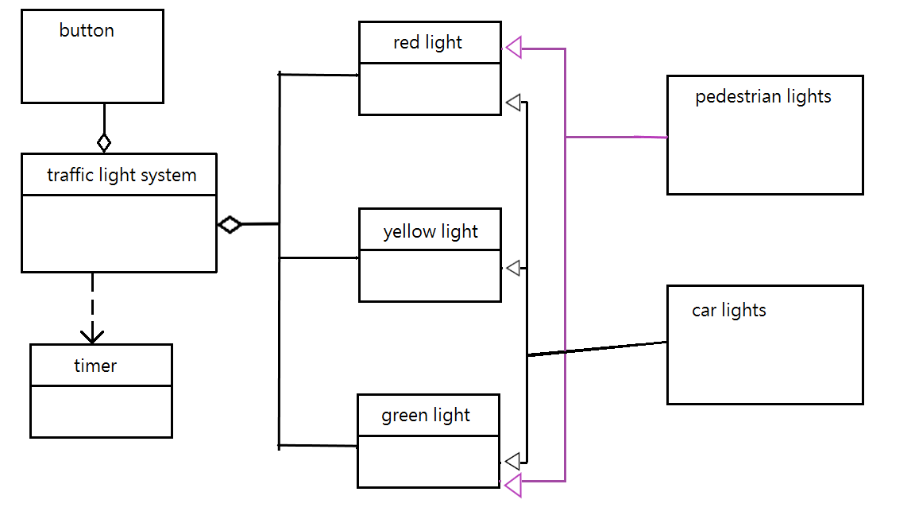
Class Diagram of Traffic Light System

Slide 4
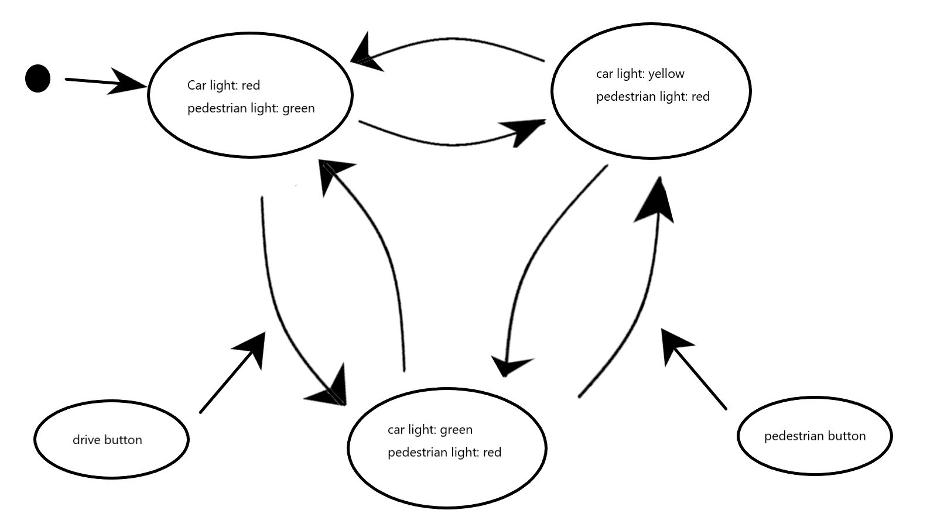
State machine diagram

Slide 5
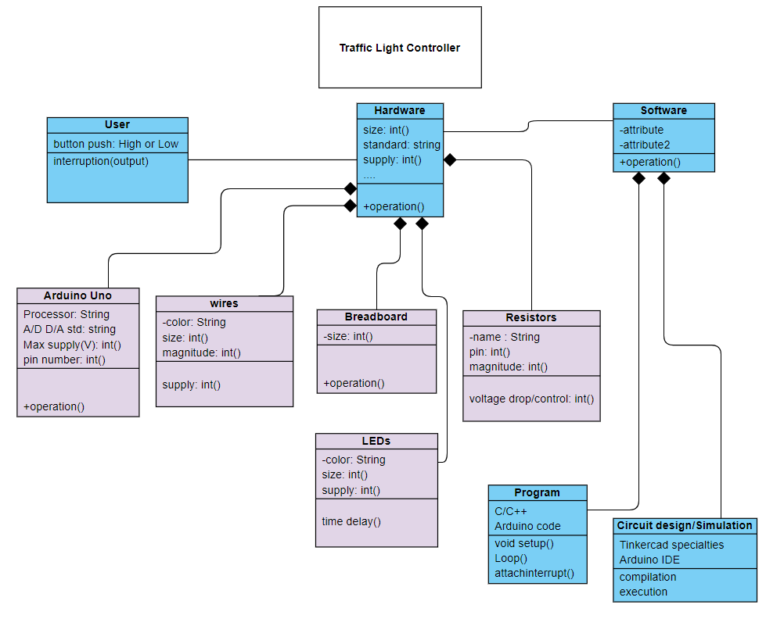
Class Diagram of Traffic Light Controller Circuit

Slide 6
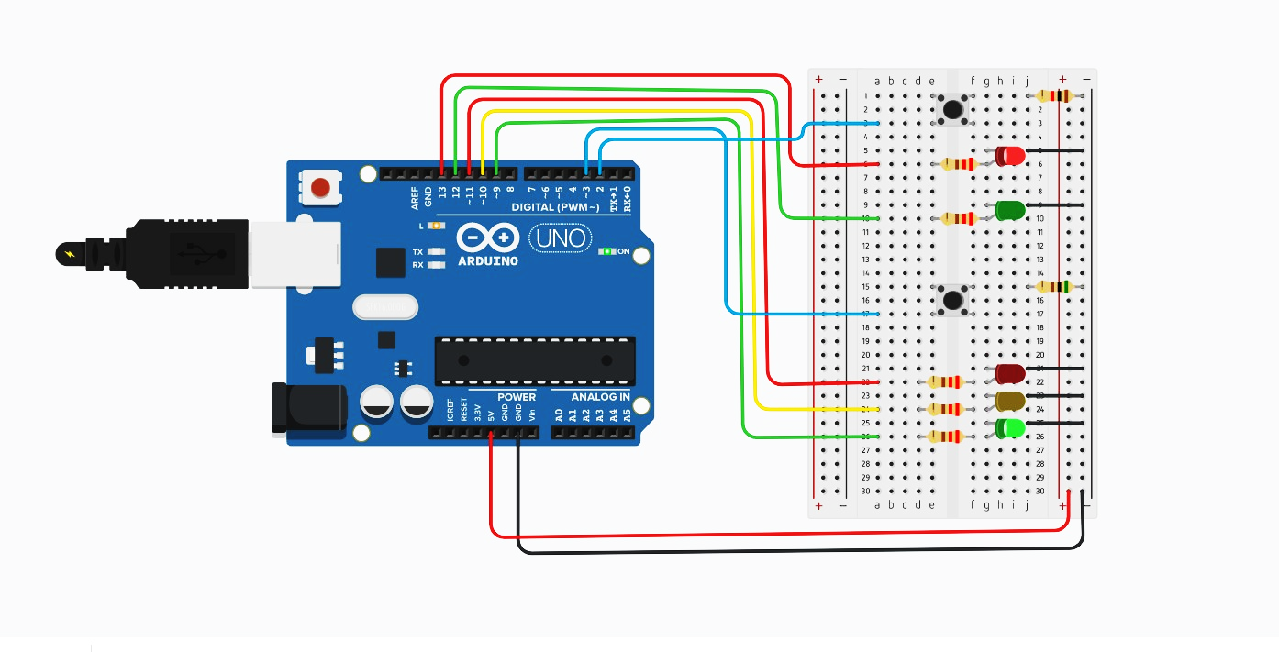
Arduino circuit board connection

Slide 7
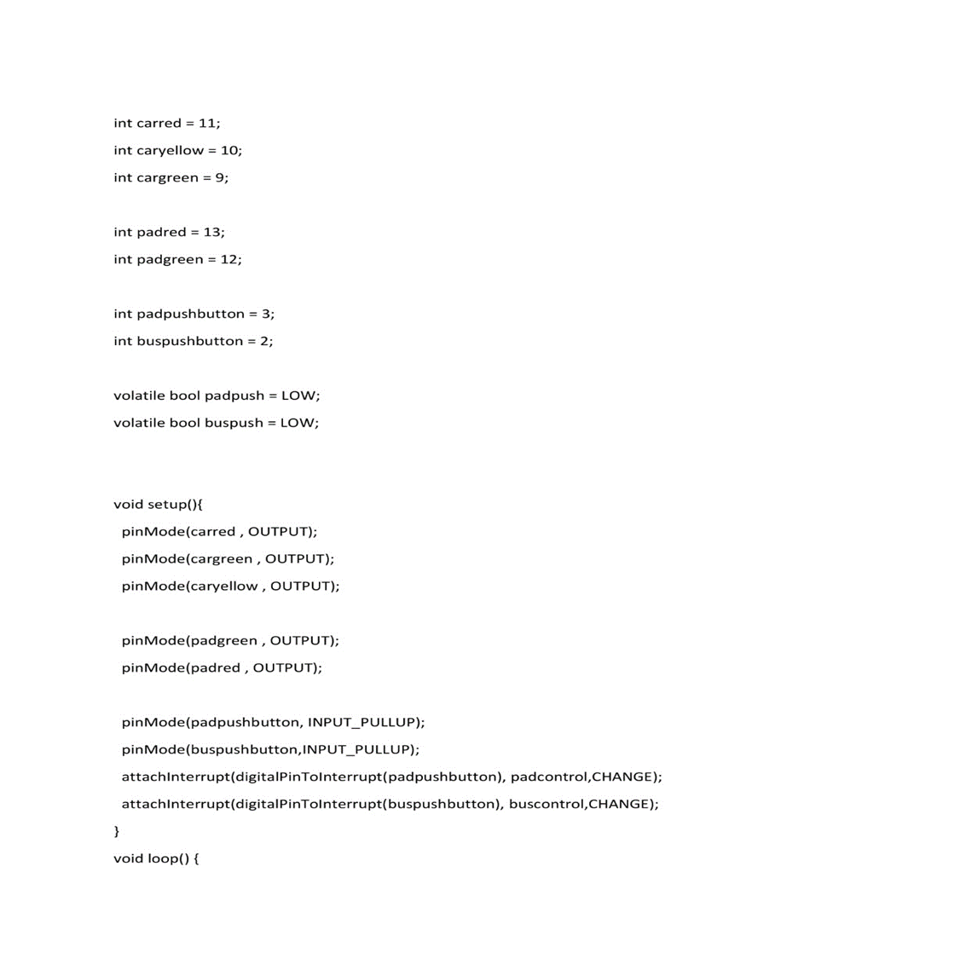
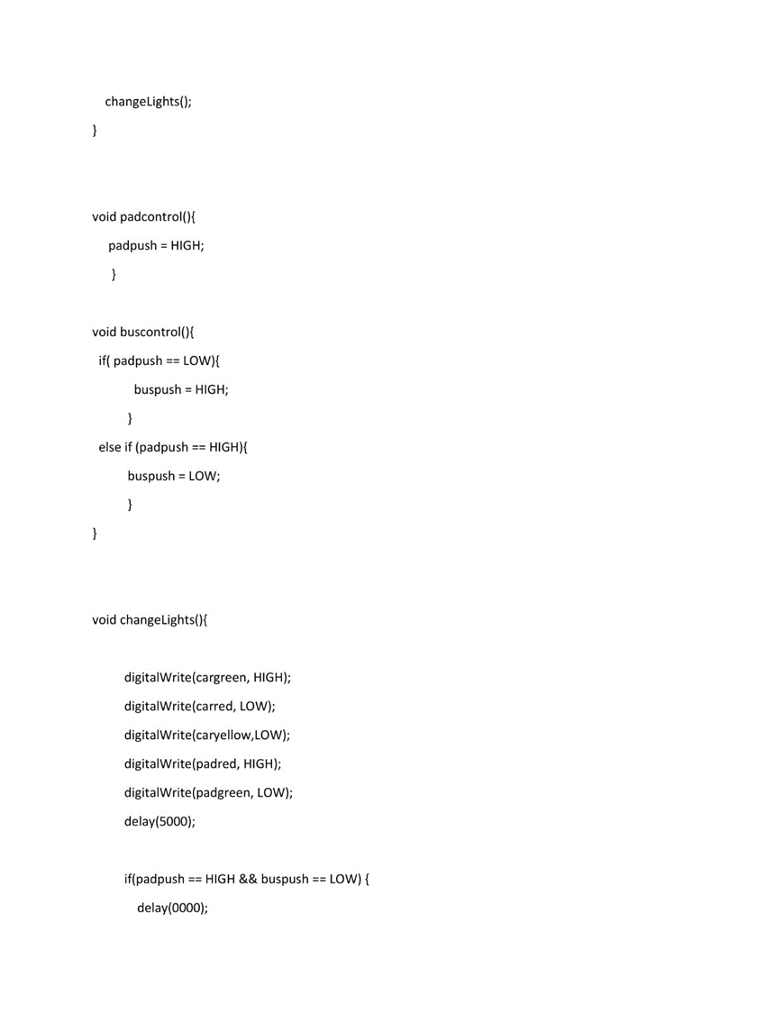
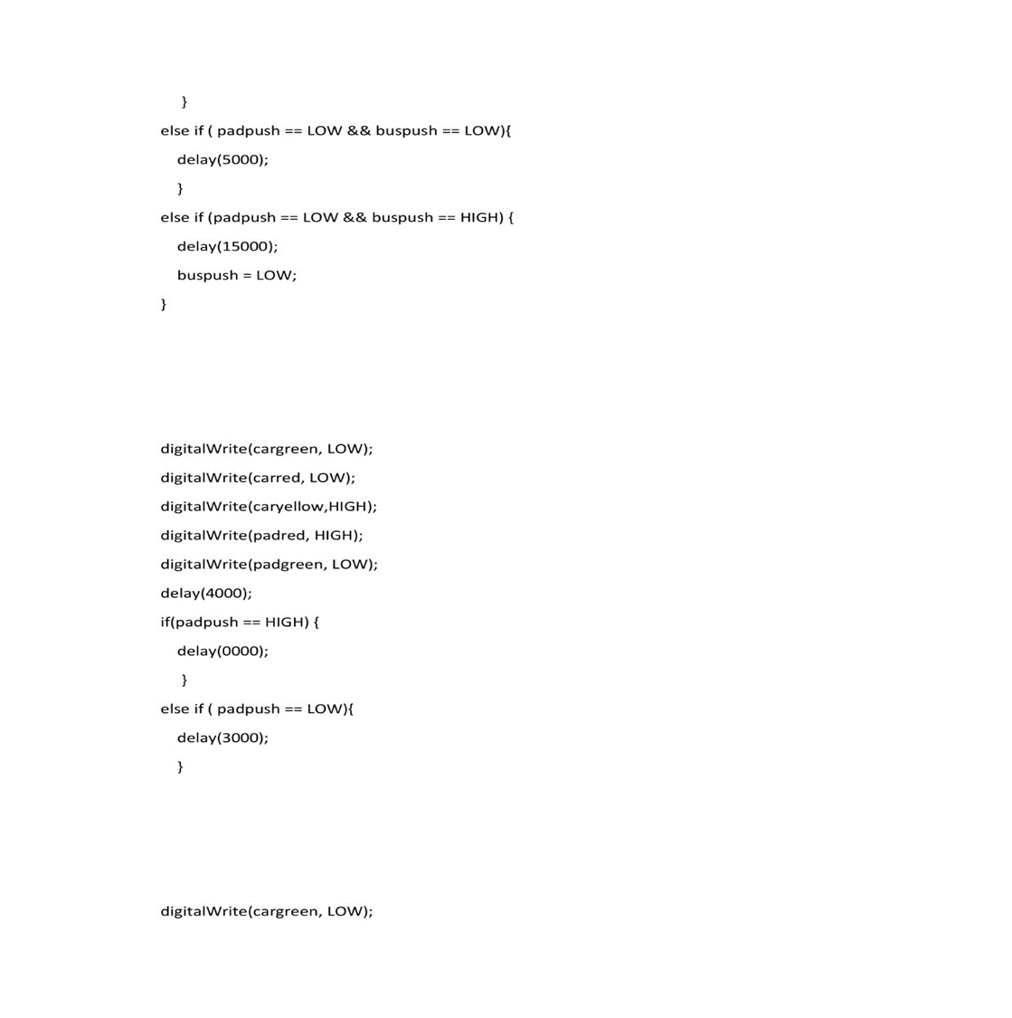
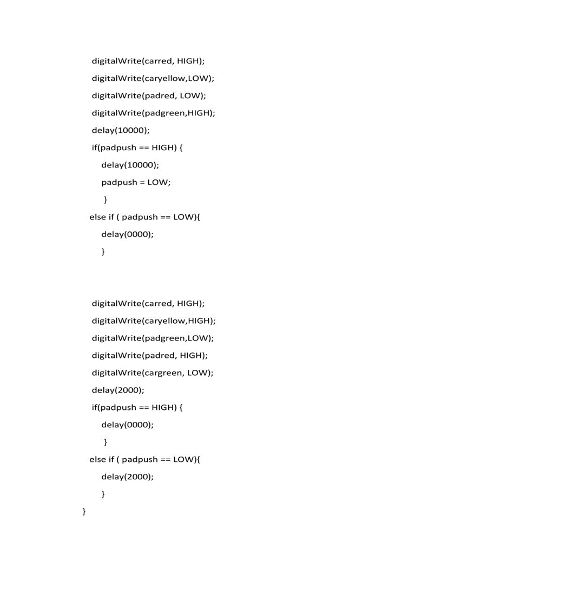
Arduino program for the System

Slide 8
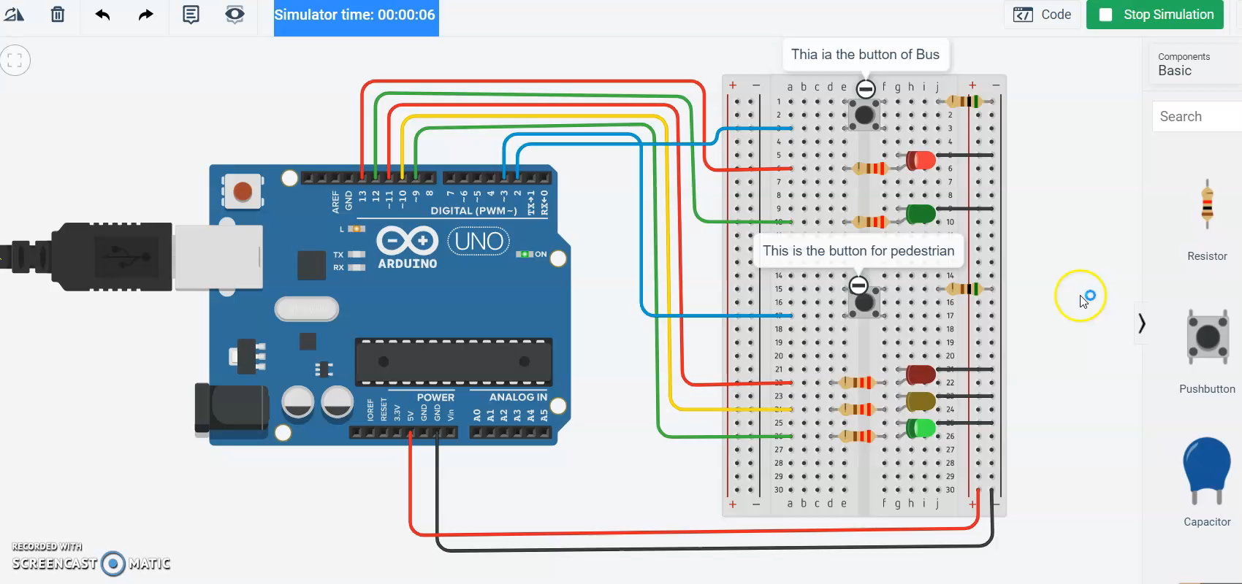
Simulations
Standard condition

Slide 9
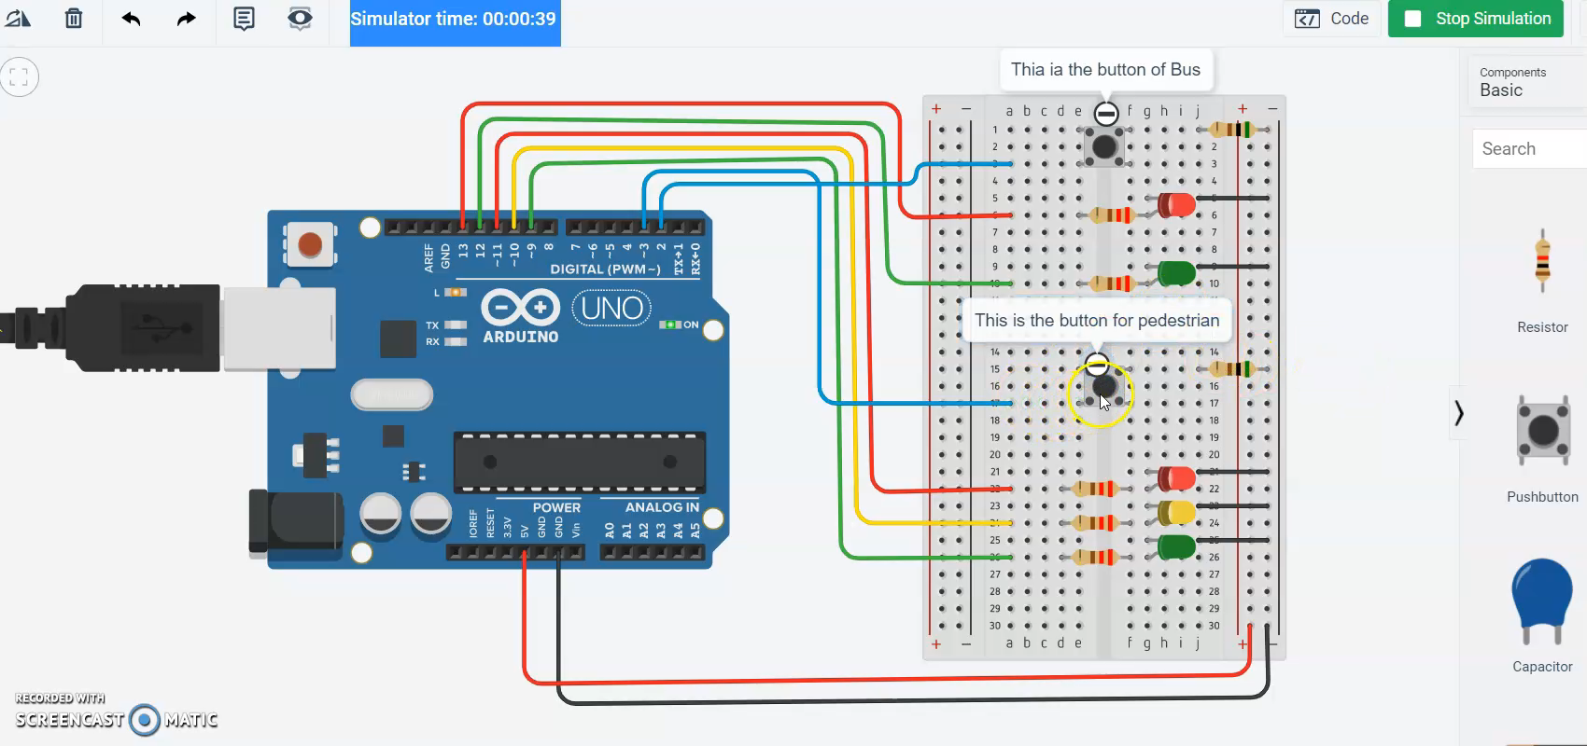

Push pedestrian-controlled button
Push driver-controlled button

Slide 10
Thank you for your attention _________

